Slide 1
Cochrane tools and systems

Slide 2
Session outline
Cochrane Review Ecosystem: an overview
Essentials tools and systems (‘must know’)
Other tools and systems (‘good to know’)

Slide 3
Cochrane Review Ecosystem
Shows the communities, applications and data stores that support the process of conducting a Cochrane Review

Slide 4
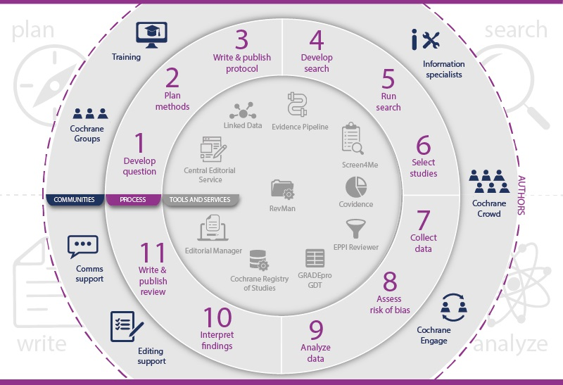
Notes:
Wondered how all the people, processes, and technologies work together to make Cochrane Reviews? The path that Cochrane Reviews follow from developing the question to final publication, can be complex to explain.
The Cochrane Review Ecosystem infographic provides a comprehensive overview of the entire life cycle of a Cochrane Review, including all the people, processes, and systems involved.

Slide 5
Notes:
In the center of the Ecosystem is the process of Cochrane Review production (purple icon ring) – from developing the question to writing and publishing the review.
The process broadly follows the stages of planning, searching, analyzing and writing (large gray icons on the outer-most ring)

Slide 6
Notes:
This process is conducted and supported by Cochrane communities (blue icon ring), consisting of different groups of people and various services.

Slide 7
Notes:
A number of tools and services are available for Cochrane Review production (light gray icon ring).
In this presentation we will focus primarily on these two inner circles of the infographic.

Slide 8
Essential tools and systems
RevMan Web
GRADEpro GDT
Editorial Manager

Slide 9
RevMan Web (RMW)
Cochrane’s cloud-based software for conducting all types of systematic reviews
You can use RMW to:
Create and manage review projects
Generate meta-analyses and forest plots
Use the calculator tool to assist in data entry
Structure and store study data (inc. 'study-centric' data)
Collaborate on writing the review protocol and report
Access and use previous review versions
Organize your team's portfolio of reviews
Notes:
[NOTE FOR TRAINERS: You can show this 5-min walk-through the RMW or share the link with learners to watch it before or after the training session: https://youtu.be/tiArKZp5U38]

Slide 10
Accessing RevMan Web (RMW)
Free access for Cochrane Review authors (with their Cochrane Account)
Paid subscription for non-Cochrane reviews
Practice reviews and templates available for new starters
RMW Knowledge Base: https://documentation.cochrane.org/revman-kb

Slide 11
GRADEpro GDT
Software that compliments RevMan in creating ‘Summary of findings’ tables in Cochrane Reviews
You can use GRADEpro GDT to:
Import data from RevMan
Perform calculations to present the key findings of your review
Conduct a GRADE assessment of the quality of evidence
GRADEpro GDT is also used in guideline development
Free access for Cochrane Review authors
On a subsription basis for non-Cochrane reviews
Available at gradepro.org

Slide 12
Editorial Manager
Cochrane uses Editorial Manager (used by over 250 other publishers including Elsevier, PLOS and OUP) to manage author submissions of Cochrane Reviews
Editors use Editorial Manager to conduct peer review and move accepted submissions to publication
Information for authors available at:
links.cochrane.org/editorial-manager-for-authors

Slide 13
Other tools and systems
Covidence
EPPI-Reviewer
Other statistical packages
Volunteer platforms:
Cochrane Engage
Cochrane Crowd

Slide 14
Covidence and EPPI-Reviewer
Covidence (covidence.org) – an online collaborative tool for:
uploading and sharing search results
screening and selecting studies
data collection
EPPI-Reviewer
Especially appropriate for complex systematic reviews
Some advance features (e.g. text mining, automatic text translation, features for qualitative analysis)
A complement to RevMan for Cochrane Reviews
A stand-alone authoring tool for non-Cochrane reviews

Slide 15
Other statistical packages
Not part of Cochrane’s offer of tools and systems for their authors
May be useful for less-common analyses (meta-regression, network meta-analysis, diagnostic test accuracy reviews)
R + add-on packages (e.g., metafor, stan)
Cost-free & open-source (R programming necessary)
Stata (± free add-on commands)
Commercial, point and click (Stata programming optional & helpful)
Excellent support and documentation
Comprehensive Meta-Analysis (CMA)
WinBugs (for network meta-analysis)
Notes:
It’s important to note that the packages listed here are not part of Cochrane’s offer of tools and systems for their authors.
Other packages may be useful for less common analyses.
Without trying to provide an exhaustive list, here are some of the more prominent examples.

Slide 16
Volunteer platforms
Cochrane Engage (engage.cochrane.org)
Volonteering platform for evidence-based health care opportunities such as:
translating studies
providing consumer peer-review
mentoring
joining author teams
Cochrane Crowd (crowd.cochrane.org)
a citizen science platform for categorising and summarising healthcare evidence (e.g. deciding whether a study is a randomised controlled trial or not)
includes pathways for learning about the key concepts in EBM

Slide 17
Take home message
Cochrane has a range of communities, applications and data stories to support the production of systematic reviews
RevMan Web is Cochrane's main software for conducting systematic reviews, freely available for authors of Cochrane Reviews and available on a subscription basis for the production of non-Cochrane reviews
Other tools and systems for production and editorial processing of Cochrane Reviews include GRADEpro GDT, Editorial Manager, Covidence, and EPPI-Reviewer
Cochrane Crowd and Cochrane Engage are volunteer platforms supporting the work of Cochrane

